Slide 1

Famous tourist places of sikkim
Class 10th B
By Tanmay Sharma
Cbse art integrated project

Slide 2
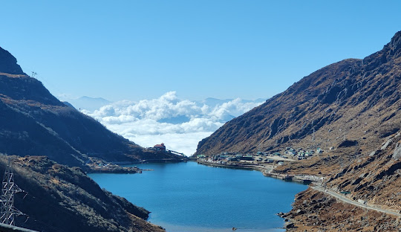
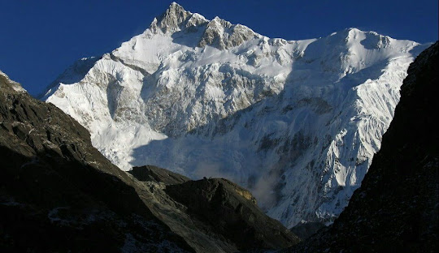
Sikkim as a whole
Sikkim offers a diverse range of attractions, from bustling city life in Gangtok to serene natural landscapes in North Sikkim. Some must-visit places include Gangtok, Pelling, Lachung, Yumthang Valley and Gurudongmar Lake.

Slide 3
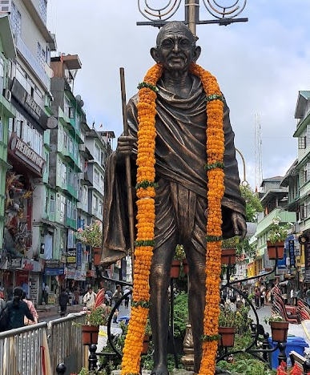
Gangtok Gangtok: The capital and largest city, known for its scenic beauty and vibrant atmosphere. Must-see spots include MG Marg, Tsomgo Lake, Nathula Pass, and the Himalayan Zoological Park.

Slide 4
Other activities while in sikkim
Trekking: Sikkim offers numerous trekking routes, including the Green Lake trek, the Dzongri trek, and the Goechala trek.
Paragliding: Enjoy the thrill of paragliding in Gangtok.
River Rafting: Experience the adrenaline rush of river rafting on the Teesta River.
Shopping: Explore local markets for traditional handicrafts, woolen garments, and souvenirs.

